Slide 1

Women's E-Commerce Clothing Reviews: An Analysis of Sentiments
By: Akarsh Singh
Henna Shah
Group 3

Slide 2
Index
Problem Setting
Data Exploration & Visualization
Model Exploration

Slide 3
Problem Setting
01
To identify patterns of the customers' purchases and reviews on a mix-bag of clothes and accessories to gauge their needs, improve products based on feedback in real-time.

Slide 4
Data Description
Clothing ID: Integer Categorical variable referring to specific piece being reviewed.
Age : Positive Integer variable of the reviewer’s age.
Title: String variable for the title of the review.
Review Text: String variable defining the review body.
Rating: Positive Ordinal Integer variable for the product score granted by the customer from 1 Worst to 5 Best.
Recommended IND: A binary variable indicating if a customer recommends a product where 1 indicates a recommendation and 0 indicates a disapproval
Positive Feedback Count: Positive Integer documenting the number of other customers who found this review positive.
Division Name: Categorical name of the product high level division.
Department Name: Categorical name of the product department name.
Class Name: Categorical name of the product class name.
23486- Rows
10- feature variables

Slide 5
Data Exploration & visualization
02

Slide 6
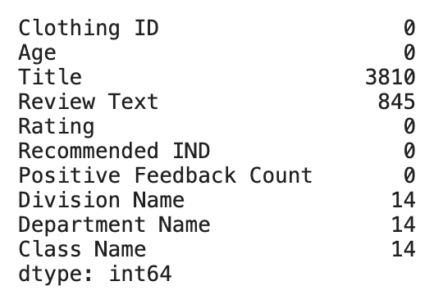
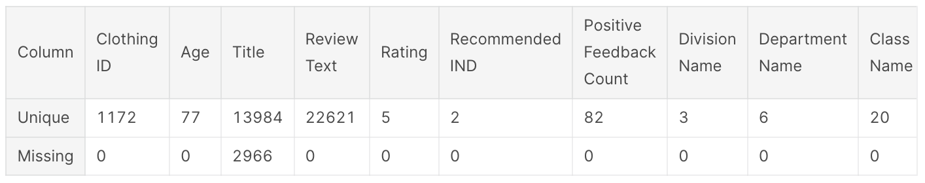
Preliminary Analysis
Checked missing and unique values as a starting point to better gauge our data and think about how missing values can be dealt with before proceeding to visualization and analysis.
Dropped missing rows from ‘Review Text’ & transformed the data Frame to show us unique and missing values together.

Slide 7
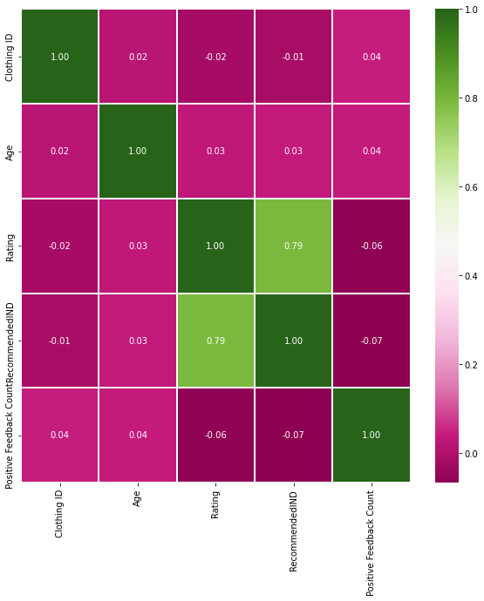
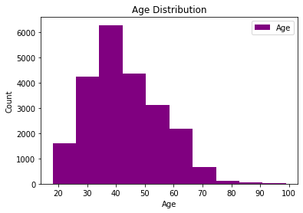
Data visualization
Heat Map
There is a negative correlation between the ratings and the positive feedback. Whereas there is a positive correlation between rating and recommended IND.
Type of ratings by different Age groups
The age group between 30-40 have given major ratings compared to senior citizens (age 65 plus) as ecommerce isn’t used more for that age.

Slide 8
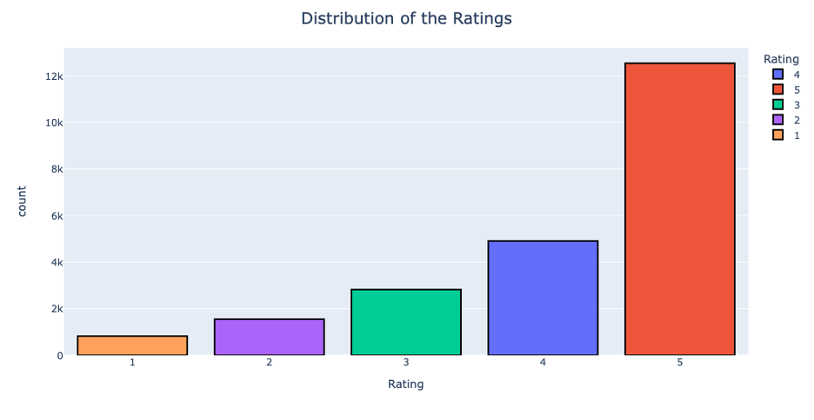
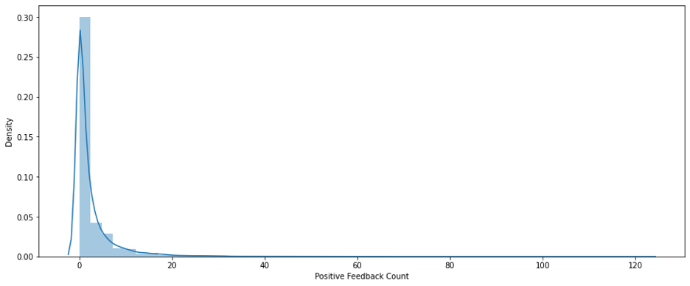
Distribution of Ratings
5 has been rated the highest
Positive Feedback basis of different Age group
There’s no notable relation between the age and positive feedback except for a few outliers.

Slide 9
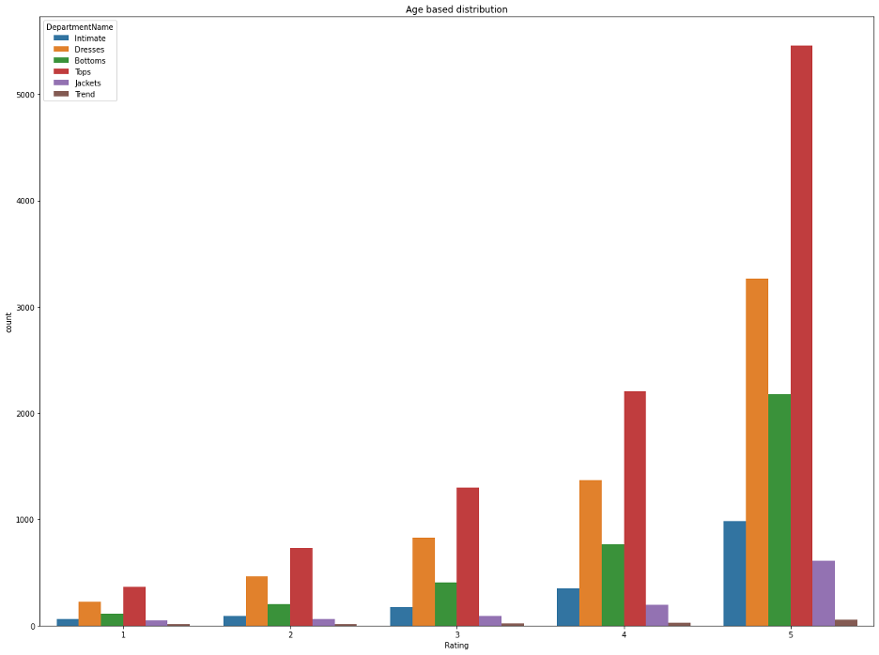
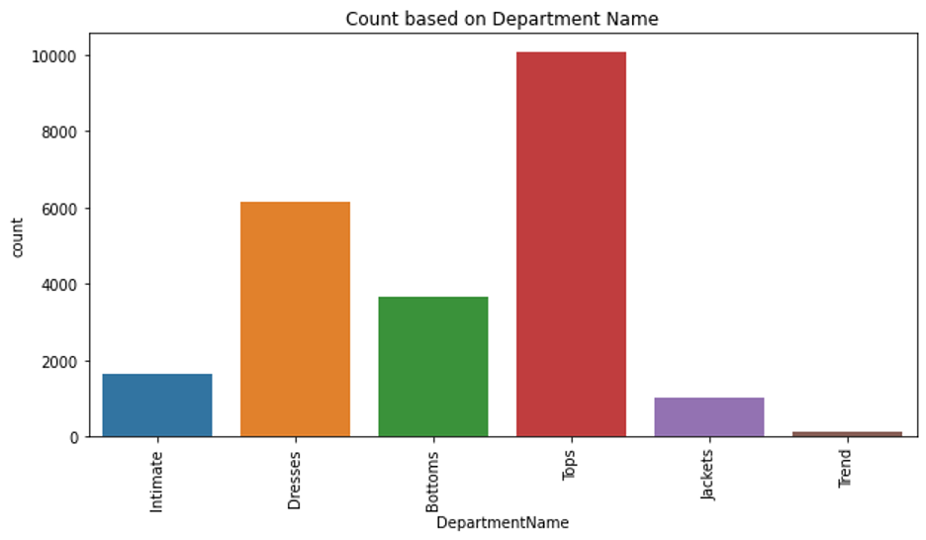
Count on basis of Department Name
Number of items for each department, tops are most in demand.
Ratings on basis of different Age groups for different department
The number of ratings is depicted based on different age groups for different departments. Tops have been more highly ranked than other items with trend being the lowest.

Slide 10
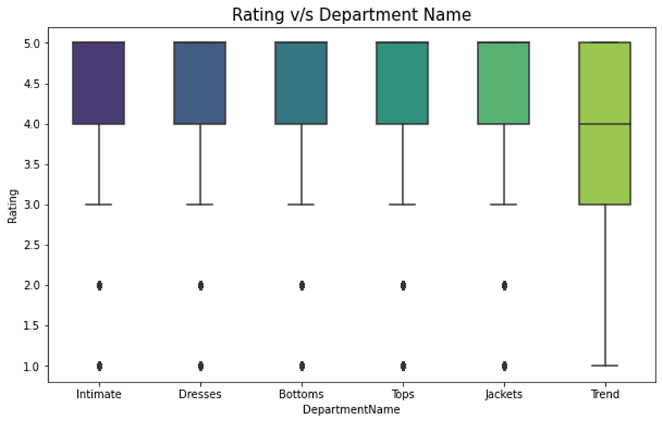
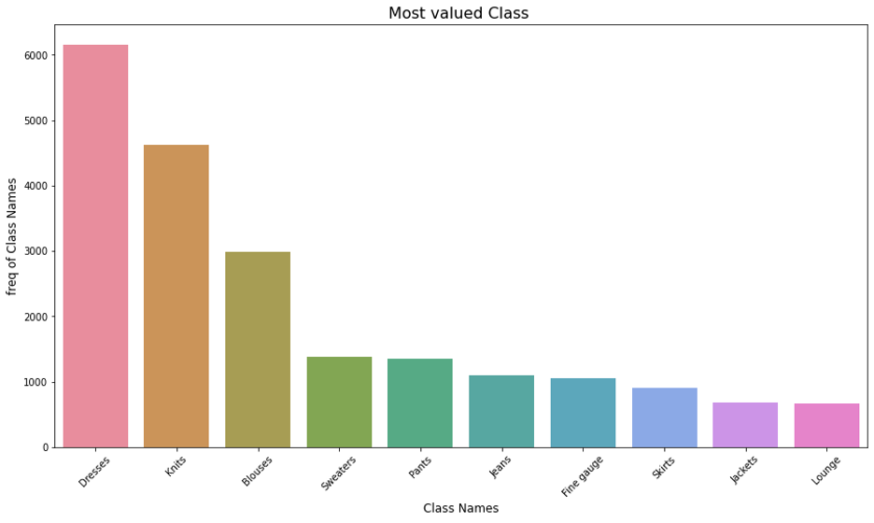
Positive Feedback basis of different Age group
Dresses are most valued class followed by knits. Lounge being the least valued class.
Rating Vs Department Name
Except for the trend department, the median for all other departments is 5. Hence, the ratings are high, and sentiment is positive in this dataset.

Slide 11
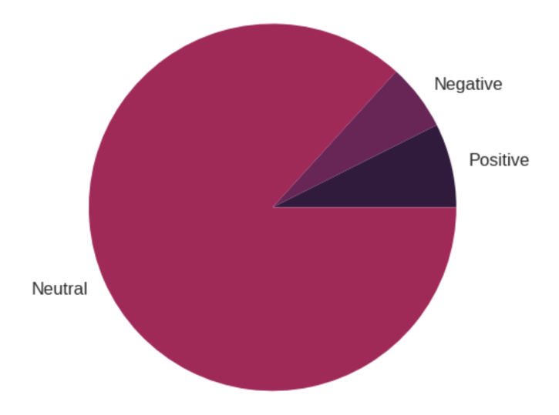
Data Processing
1
Polarity
By using a popular library called TextBlob we generated a polarity column that rates a sentence's polarity between -1 (Negative) and 1 (Positive
2
Review Length
The total number of characters in a review. This could range from 0 to infinity
3
Word count
This metric is proportional to review length and contains the number of words in a review. Range: 0 to infinity.

Slide 12
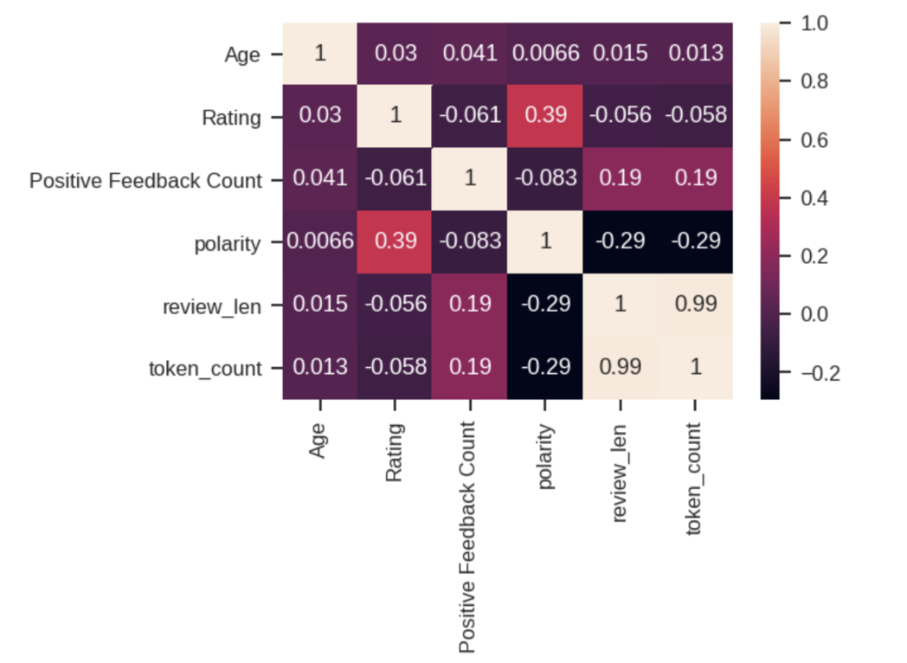
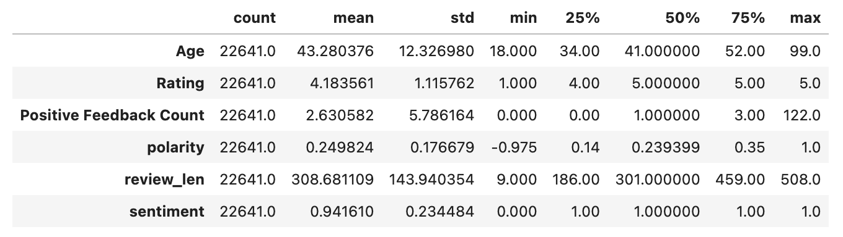
From this confusion matrix, we can see that token_count and review_len are highly collinear. This will lead to multi-collinearity issue when we feed this data to a model.
Final Summary of the data

Slide 13
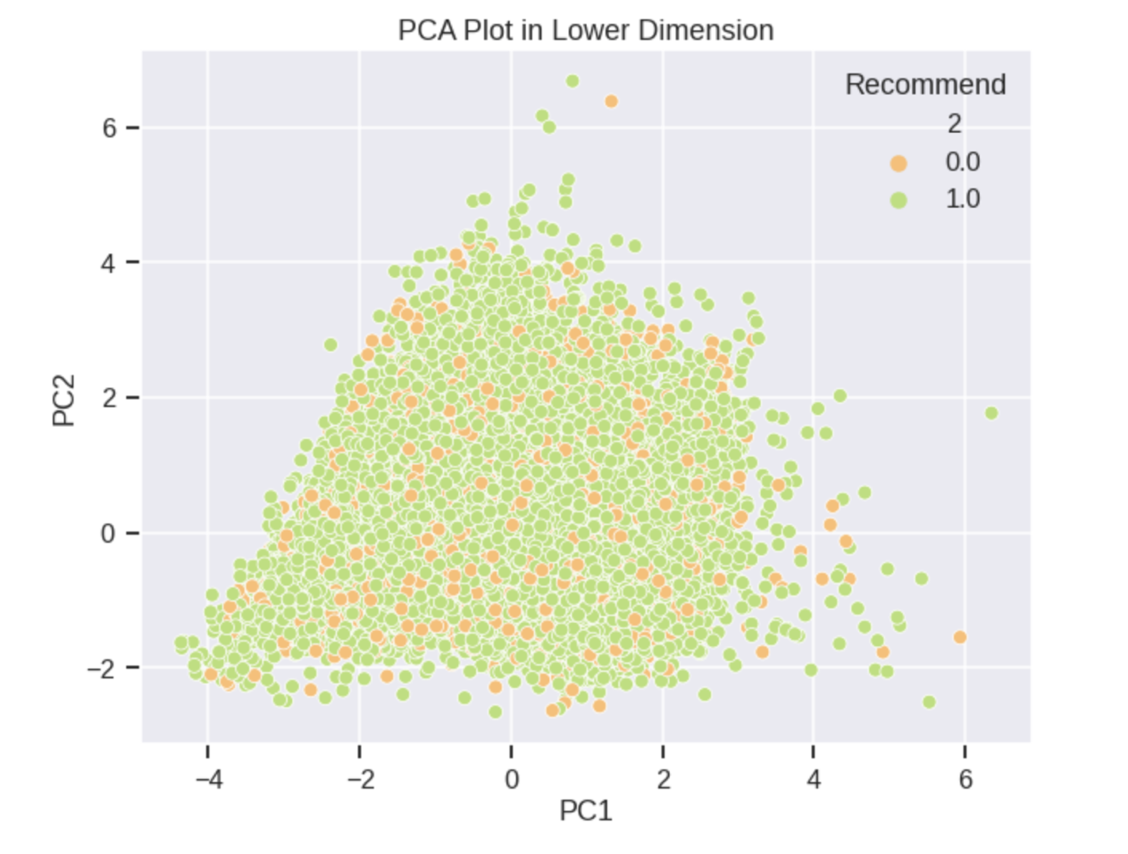
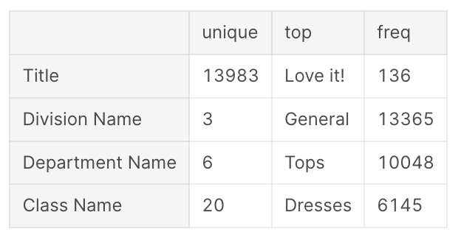
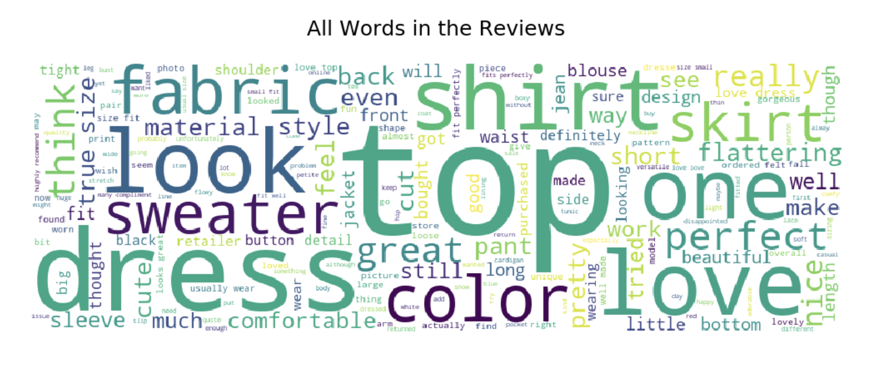

Slide 14
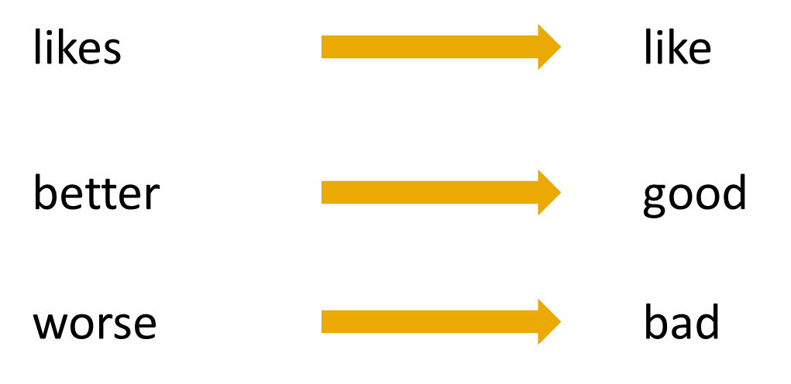

Lowercase
Tokenization
Stop Words Removal
Lemmatization
Low Frequency Removal
Sentence
Vectorization
Lemmatization Example
Stop Words Removal Example

Slide 15
Findings
Approximately 3000 missing values are present which is only 1% of the data
50% of the positive feedback comes from the top 20% reviews
31 – 52-year-old people are 66.5% of the reviewers according to the data distribution
The dataset is highly imbalanced with 82% of values in the class of interest (1: Recommended)
The top 3 items received an average rating of ~4.2, and an average recommendation rate of 83%..
According to the polarity calculations, most of the reviews are of neutral polarity
Since most reviews are highly positive it will be a challenge to balance specificity with high sensitivity.

Slide 16
Model Performance Evaluation & interpretation
03
We look forward to training and validating our model using two approaches. First, we can use standard classification models based on multiple features available to generate predictions and compare them. A second approach would be to further process review text and tokenize/vectorize reviews to feed into a deep learning model.

Slide 17
Candidate Models
SVM
Gradient Boost
Random Forest
Naïve Bayes
Logistic Regression
Neural Network (LSTM)

Slide 18
Dataset
Tabular (No Text Mining)
Naïve Bayes
Tree Based Models
Vectorized (Text Mining)
Neural Network
Logistic Regression
SVM
Train/Validation Split: 0.75/0.25
Metrics For Evaluation
ROC/AUC
Confusion Matrix (Accuracy, Precision, Recall, TPR, FPR)
Threshold Estimation
GridSearchCV (Hyperparameter Tuining)

Slide 19
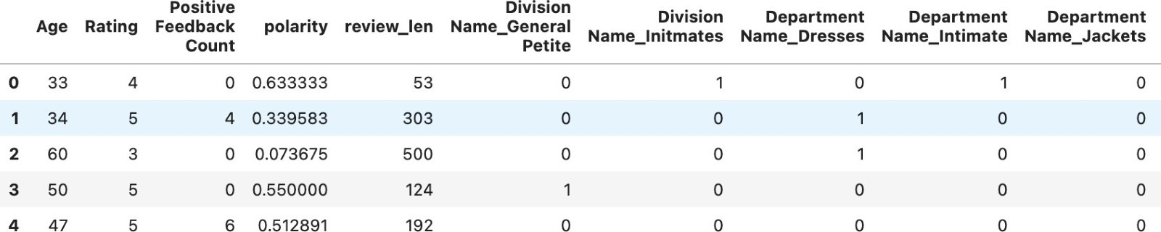
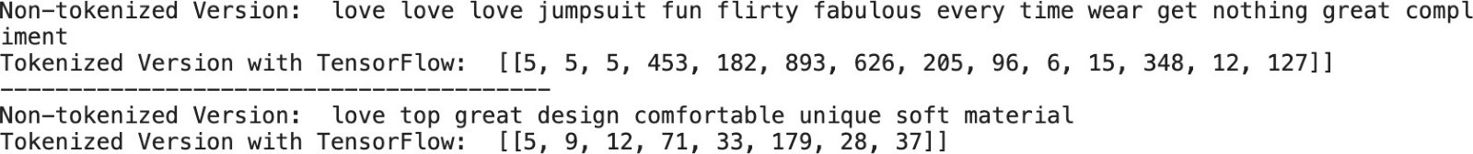
No Text Mining
Text Mining

Slide 20
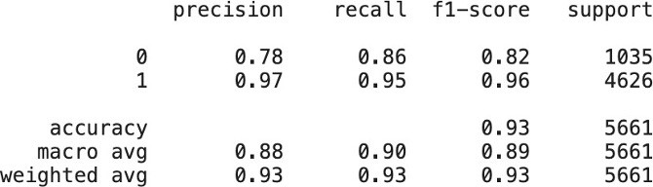
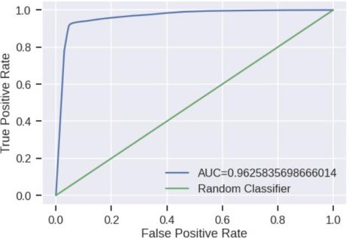
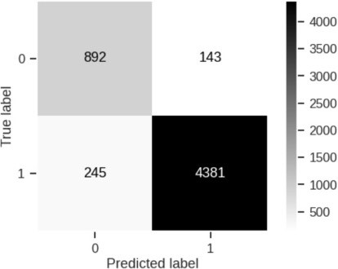
Random Forest Result (Example)
ROC/AUC
Confusion Matrix

Slide 21
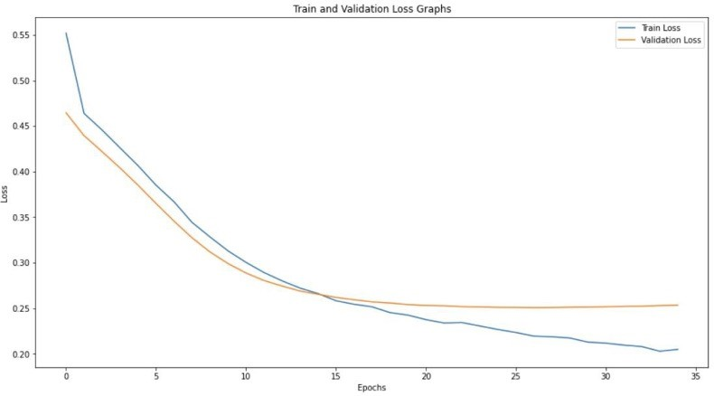
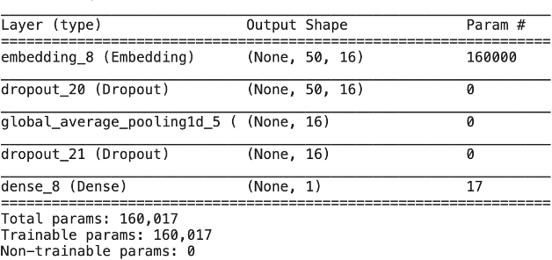
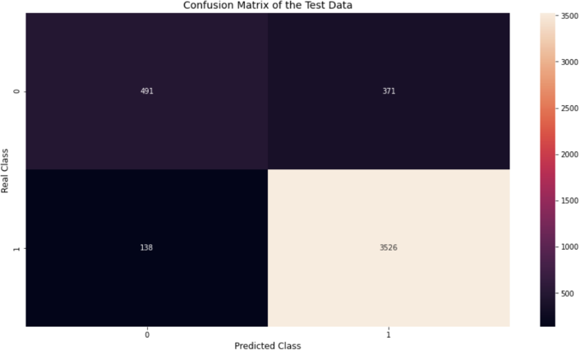
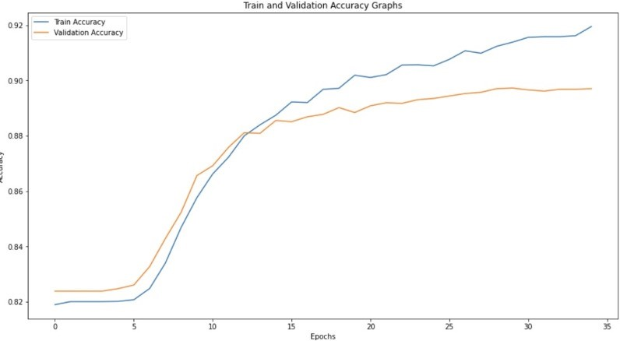
Neural Network Results
Model Summary

Slide 22
Performance Summary of All Models
Sr No | Model | Sensitivity | Specificity | ROC/AUC
1 | KNN | 98.2 | 66.8 | 0.85314
2 | Naïve Bayes | 93.1 | 89.1 | 0.96551
3 | Gradient Boost | 92.9 | 95.0 | 0.96961
4 | Random Forrest | 94.7 | 86.1 | 0.92582
5 | Neural Network | 96.2 | 56.9 | 0.81345

Slide 23
References
https://www.kaggle.com/datasets/nicapotato/womens-ecommerce-clothing-reviews/code?datasetId=11827&sortBy=voteCount
https://www.geeksforgeeks.org/python-programming-language/
https://stackoverflow.com/

Slide 24
Thank You

